Slide 1
Q & A session for INFS 4205/7205
-- A brief review
Fengmei Jin
fengmei.jin@uq.edu.au

Slide 2
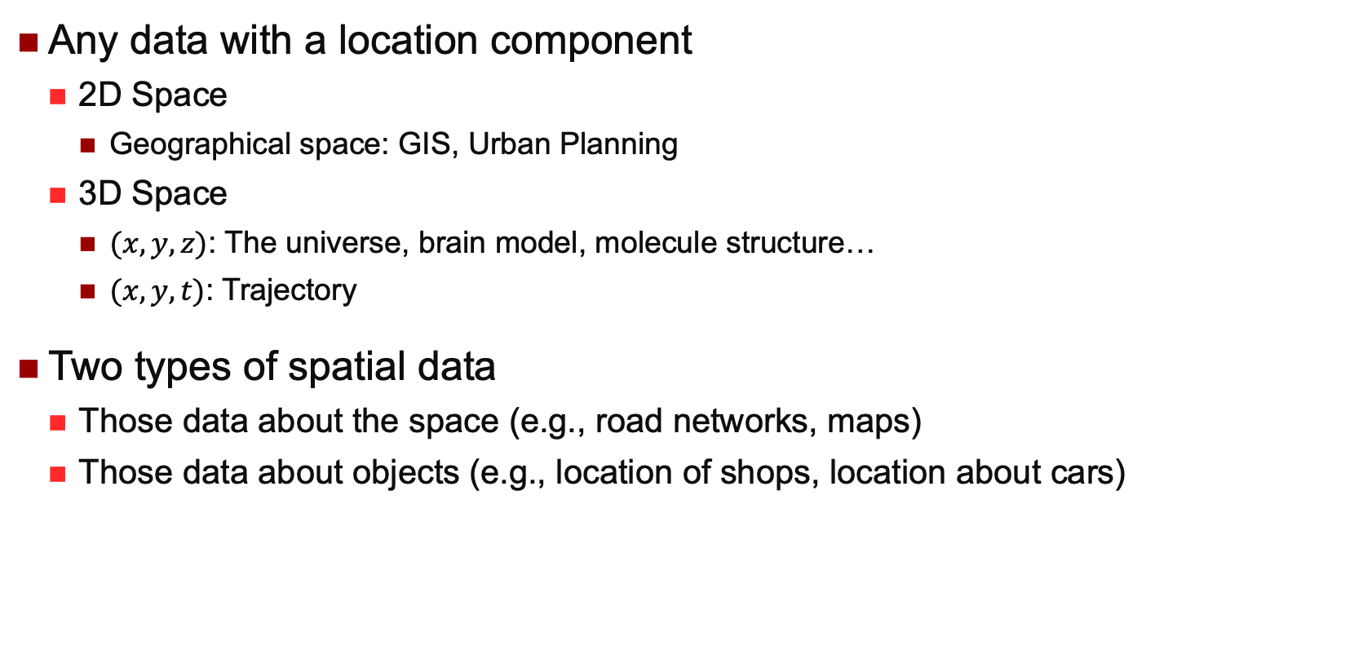
Spatial Data
Any data with a location component
2D Space
Geographical space: GIS, Urban Planning
3D Space
$(x,y,z)$: The universe, brain model, molecule structure…
$(x,y,t)$: Trajectory
Two types of spatial data
Those data about the space (e.g., road networks, maps)
Those data about objects (e.g., location of shops, location about cars)

Slide 3
Spatial DBMS
A spatial database system is a database system
It offers spatial data types in its data model and the query language
It supports spatial data types in its implementation, by providing spatial indexing and efficient algorithms for spatial join queries and other types of spatial queries
Retrieve the spatial data without scanning the whole set

Slide 4
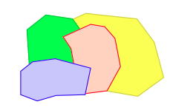
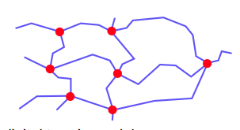
Spatial Data Models
Objects in space (Object-based)
Single objects
Point (location, POI)
Line / Polyline (River, Cable, Road)
Polygon or Region (Forest, Lake, City)
Spatially related collections of objects
Partition (Land use, districts, land ownership)
Network (Roads, rivers, electricity, phone)
4
Area-ID | Dominant Tree | Area
FS1 | Pine | [(0,2), (4,2), (4,4), (0,4)]
FS2 | Fir | [(0,0), (2,0), (2,2), (0,2)]
FS3 | Oak | [(2,0), (4,0), (4,2), (2,2)]
Pine
2
Fir
Oak
0
2
4
Notes:
There are two kinds of spatial data models;

Slide 5

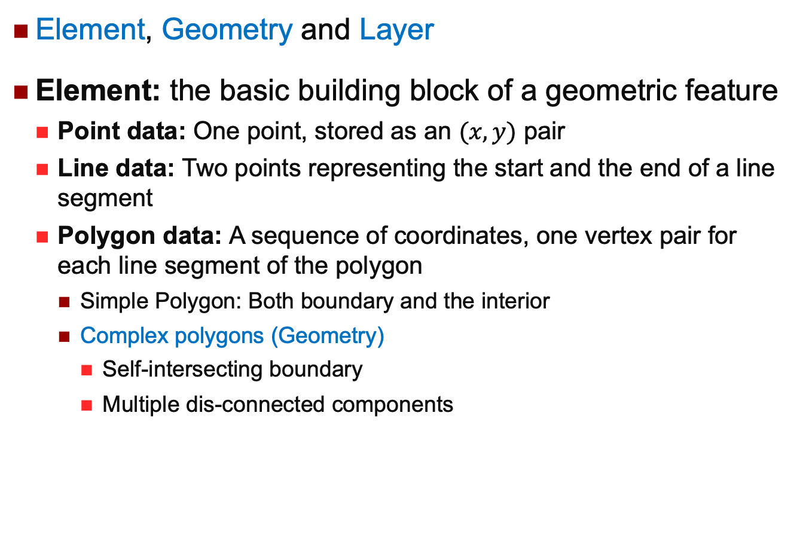
Spatial Data Model in Oracle
Element, Geometry and Layer
Element: the basic building block of a geometric feature
Point data: One point, stored as an $(x, y)$ pair
Line data: Two points representing the start and the end of a line segment
Polygon data: A sequence of coordinates, one vertex pair for each line segment of the polygon
Simple Polygon: Both boundary and the interior
Complex polygons (Geometry)
Self-intersecting boundary
Multiple dis-connected components
Notes:
Different database systems may have different spatial data modles;

Slide 6

Spatial Data Model in Oracle
Geometry: representation of a user’s spatial feature, modelled as an ordered set of elements
Each geometry has a unique ID, and can be associated with a set of attributes
A geometry might describe a lake
A polygon with nested polygons for islands
Attributes such as lake name, water capacity, fauna, flora, …

Slide 7
Spatial Data Model in Oracle
Layer: a collection of geometries having the same attribute set
Examples: soil types, road network, political boundaries, population density, crops, weather conditions,…

Slide 8
Spatial Relationships
Topological
Invariant under translation such as rotation and scaling
Directional
E.g., Above, Left, North of,…
May change with rotation
Metric
E.g., Distance, Length, Area,…
May change with scaling

Slide 9
The 9-Intersection Matrix
A_{b}: boundary
A_{i}: interior
A_{e}: exterior
Each element is either 1 or 0.
Egenhofer, M.J.; Herring, J.R. (1990). "A Mathematical Framework for the Definition of Topological Relationships"

Slide 10
Spatial Indexing
Purpose:
Efficiency in processing spatial selection, join and other spatial operations
Two strategies to organize space and objects
Map spatial objects into 1D space and use a standard index structure (B-tree)
Dedicated external data structures
Basic ideas
Approximation
Bounding box, Grids
Hierarchical Data Organization

Slide 11
Object Approximation
A fundamental idea of spatial indexing is the use of approximation
Continuous Approximation
Object centric
Example:
Use of MBRs (Minimum Bounding Rectangles)
R-Tree
Grid Approximation
Space centric
Faster mapping
Uniform / Non-uniform
High-D?
Example:
Quad-Tree

Slide 12
Line Data
Arbitrary direction and shape
Use MBR and treat like polygons
Treated as trajectory data
Straight line segments with ‘perpendicular directions
Align parallel the axis
Interval Tree
Straight line segments with different directions
Use Point Index techniques to index the two end points separately
Segment Tree
Notes:
Hereafter, we study a lot of various indexing structure to solve various line data’s query

Slide 13
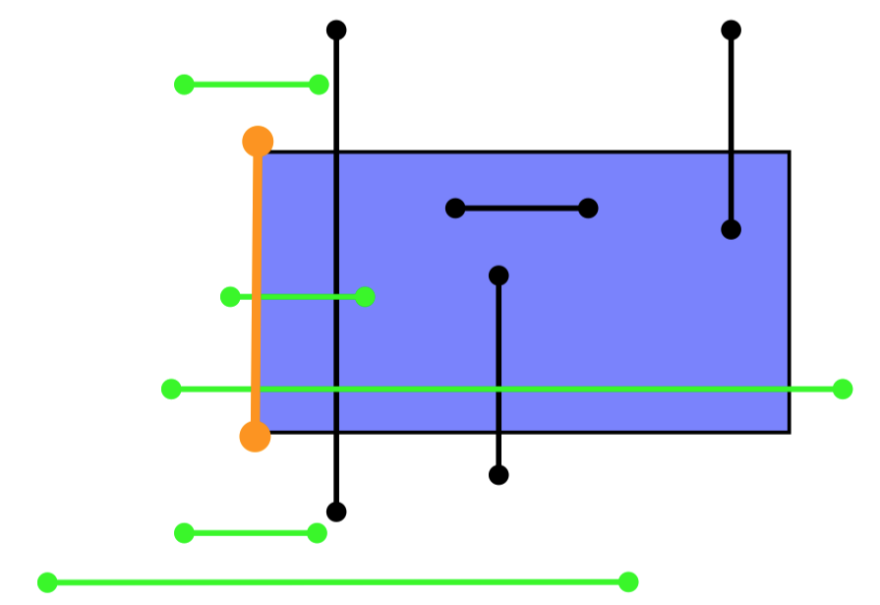
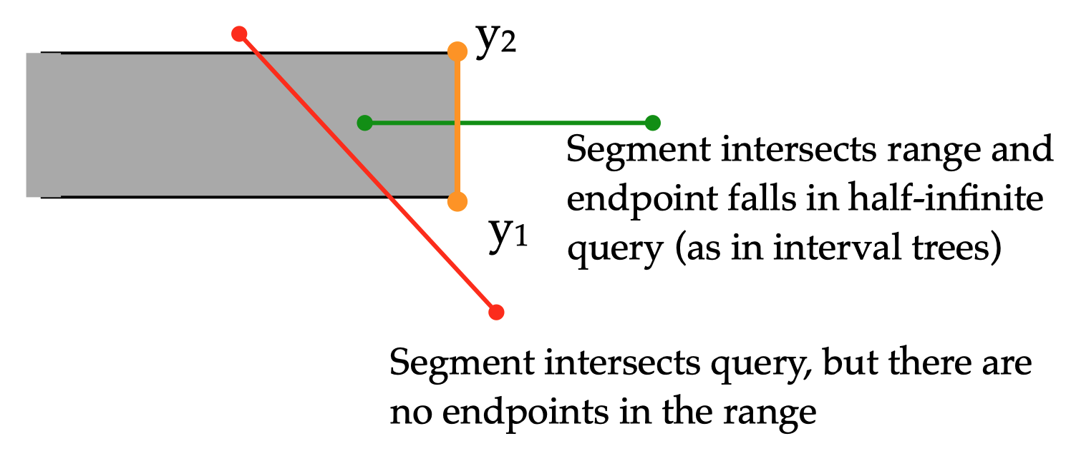
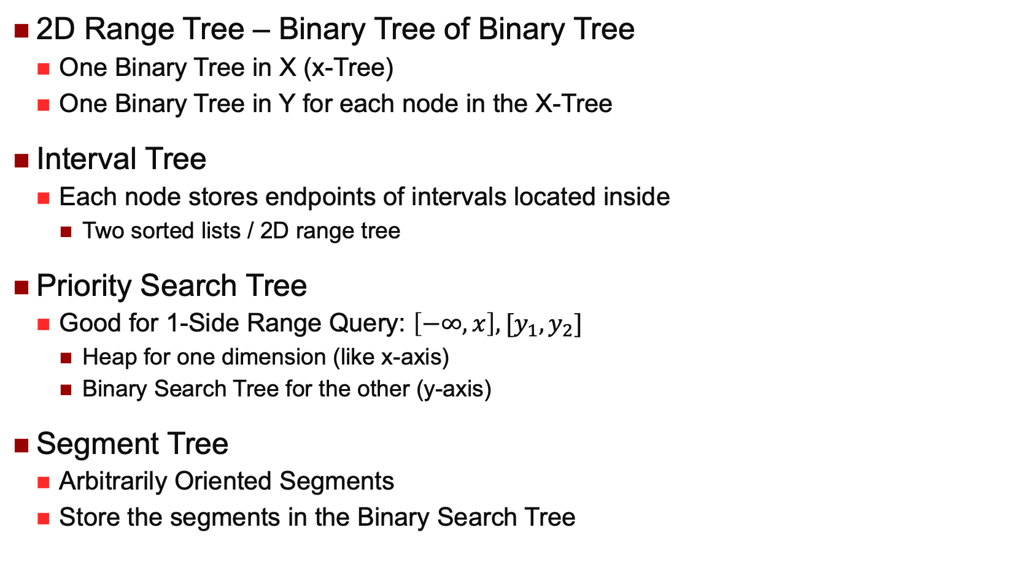
Indexing Structures for line/segment query
2D Range Tree – Binary Tree of Binary Tree
One Binary Tree in X (x-Tree)
One Binary Tree in Y for each node in the X-Tree
Interval Tree
Each node stores endpoints of intervals located inside
Two sorted lists / 2D range tree
Priority Search Tree
Good for 1-Side Range Query: $\left[−∞,x\right], [y_{1},y_{2}]$
Heap for one dimension (like x-axis)
Binary Search Tree for the other (y-axis)
Segment Tree
Arbitrarily Oriented Segments
Store the segments in the Binary Search Tree

Slide 14

Point Quadtree
Insertion
Random insertion roughly $N\log_{4}{N}$
When is the worst case?
Insertion takes $N(N−1)/2$
P1
p₈
NW
SE
p₇
NE
SW
p₃
p₆
P2
P3
P5
p₂
p₁
P6
P7
p₅
P8
N
W
E
S

Slide 15
Region Quadtree
PR Quadtree
p₈
p₇
p₃
NW
SE
NE
SW
p₆
p₂
P3
P5
P1
p₁
P8
P7
P6
P2
p₅
Based on regular decomposition of the universe
Recursively decomposing a region into four congruent blocks
Only leaves contain data

Slide 16



kd-Tree Construction
p1
$$x$$
p₆
p₃
p3
p2
$$y$$
p₂
p₁
p7
p6
p4
$$x$$
p₇
p₄
p₅
p5
$$y$$
Depends on the order of insertion (not robust for sorted data).
Variations: non-alternative, data at leaves only, representing regions etc.

Slide 17
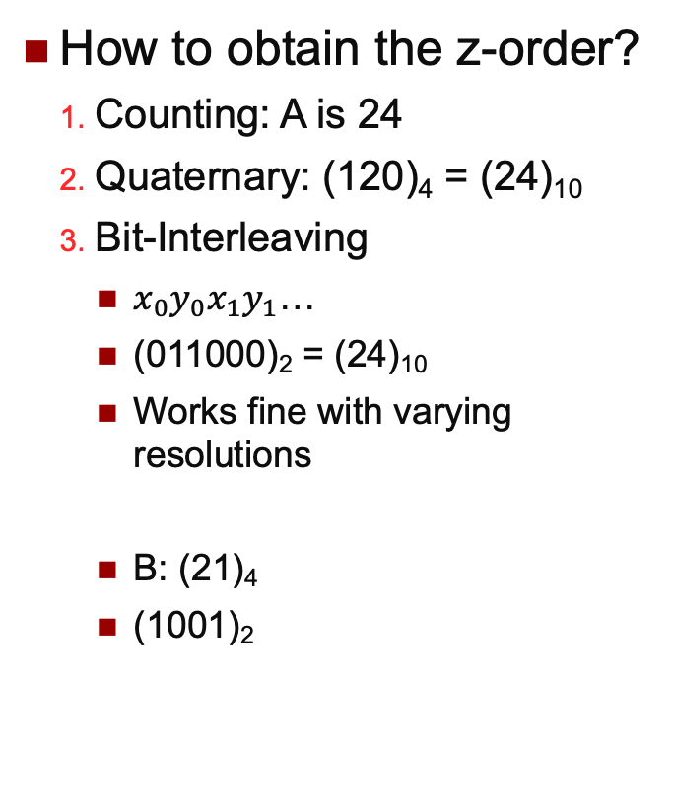
Z-Order
How to obtain the z-order?
Counting: A is 24
Quaternary: (120)₄ = (24)₁₀
Bit-Interleaving
$x_{0}y_{0}x_{1}y_{1}$…
(011000)₂ = (24)₁₀
Works fine with varying resolutions
B: (21)₄
(1001)₂
111
11
1
110
10
101
100
A
011
B
01
010
0
001
1
3
00
000
0
2
000
001
010
011
100
101
110
111
00
01
10
11
0
1
x
Notes:
Map high-dim data to on—dimensional while keeping the locality, then use index like b-tree for combination

Slide 18
Z-Value Example
B Covers C (Base 4)
B: 21
C: 210
B covers C (Base 5)
B: 320
C: 321
111
11
1
110
10
101
100
A
011
B
01
010
C
0
001
1
3
00
000
0
2
000
001
010
011
100
101
110
111
00
01
10
11
0
1
x

Slide 19
Transformation: Using Z-Ordering
Granularity
{11}, or {111, 112, 114}, or {111, 1121, 1123, 1124, 1141, 1142}
When decomposition stops
Current cell either fully
out or in the polygon
Reached the “resolution”
2
4
1
3
…the entire space is 1.

Slide 20
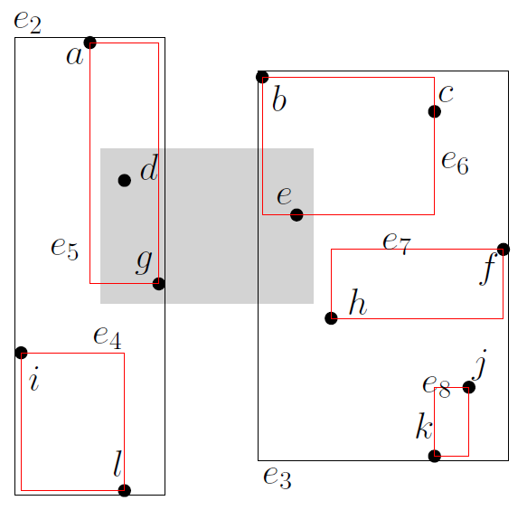
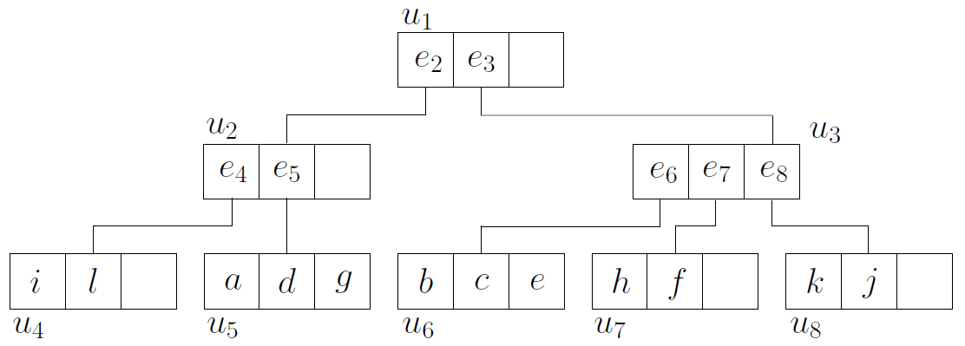
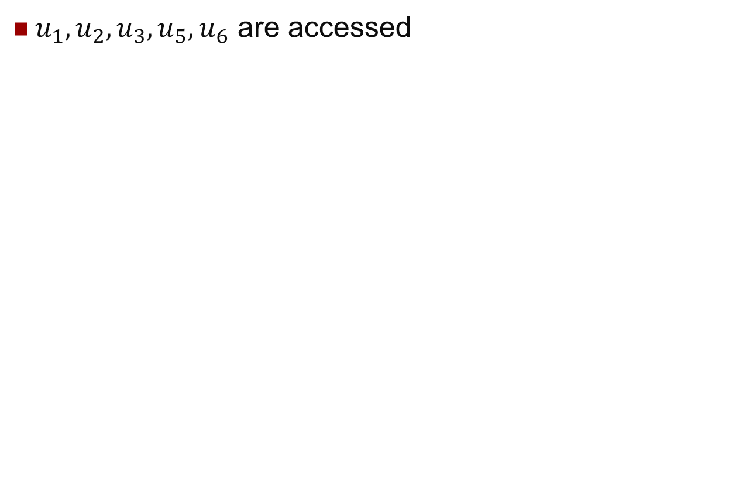
R-Tree Range Query
$u_{1},u_{2},u_{3},u_{5},u_{6}$ are accessed

Slide 21
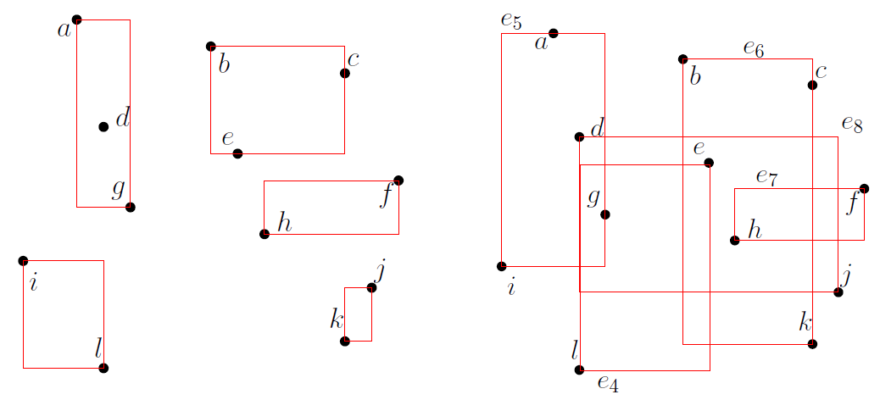
R-Tree Construction
R-Tree construction can be “arbitrary”
Bottom-up
No formal constraint on the grouping of data into nodes
The left tree has a smaller perimeter sum than the right one

Slide 22
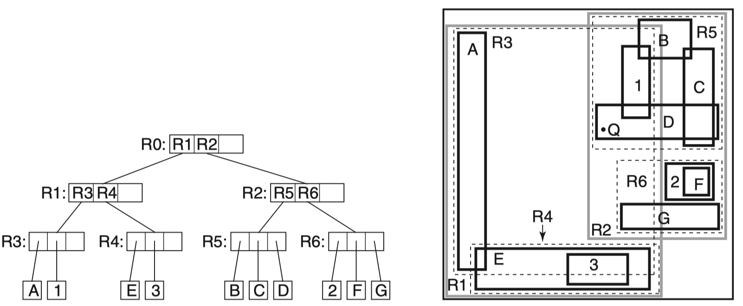

Clipping
Motivation
R-Tree: May examine all the MBRs at all levels
Because the MBR may overlap, the space is not disjointly decomposed
Query point$Q$ in the example
Single search path for a point query
Notes:
Drawback of R-tree

Slide 23
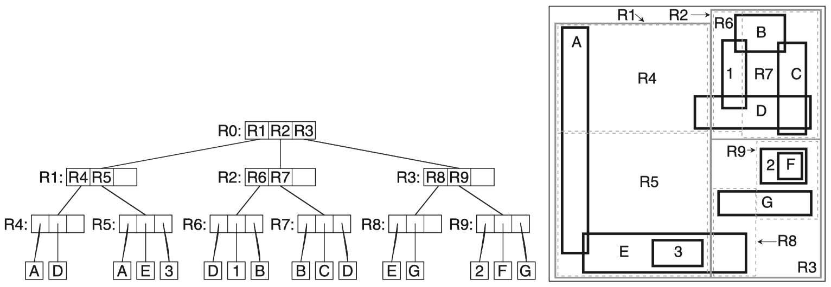
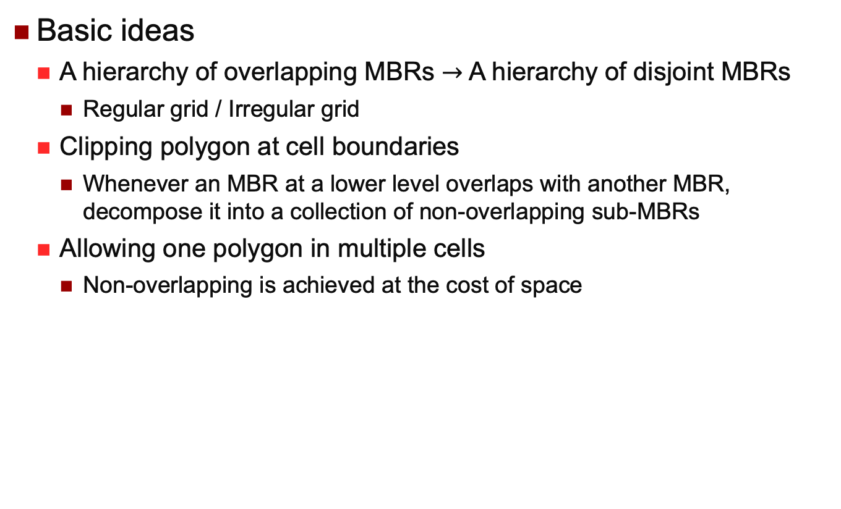
R⁺-Tree
Basic ideas
A hierarchy of overlapping MBRs $→$ A hierarchy of disjoint MBRs
Regular grid / Irregular grid
Clipping polygon at cell boundaries
Whenever an MBR at a lower level overlaps with another MBR, decompose it into a collection of non-overlapping sub-MBRs
Allowing one polygon in multiple cells
Non-overlapping is achieved at the cost of space
Notes:
Drawback:
Multiple index entries for an object: Increased search time (return the same object more than once for window query)
Overflow more likely

Slide 24
Filter-and-Refine
A most commonly used processing strategy
Motivation
Avoid expensive spatial processing as much as possible
Basic Idea
A filter step, followed by a refinement step
Filter step: applying simple operations on approximations of spatial objects
Refinement step: applying the actual spatial operations on the full geometry of spatial objects
Notes:
Filter by some approximation
Refine with the full geometry

Slide 25


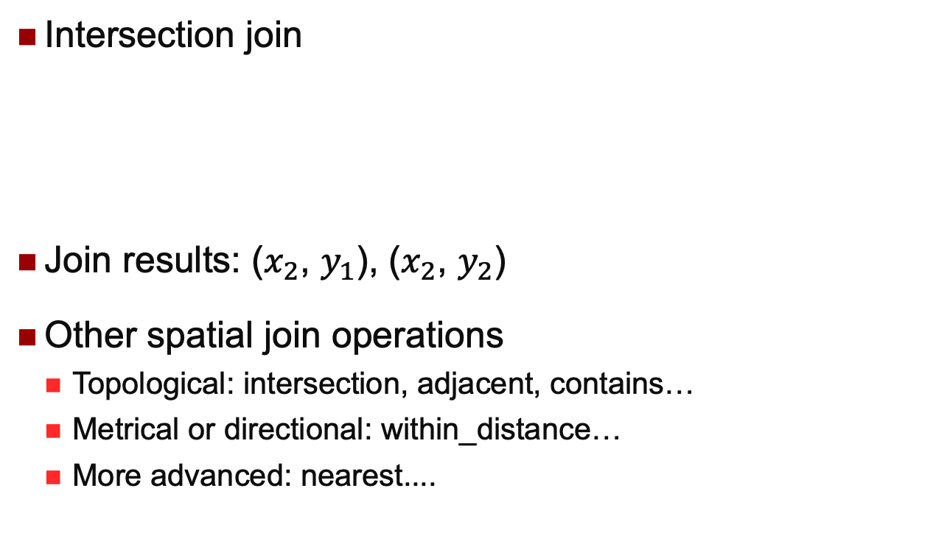



Spatial Join Example
Intersection join
Join results: ($x_{2}$, $y_{1}$), ($x_{2}$, $y_{2}$)
Other spatial join operations
Topological: intersection, adjacent, contains…
Metrical or directional: within_distance…
More advanced: nearest....
$$x_{1}$$
$$y_{1}$$
$$y_{3}$$
$$x_{2}$$
$$y_{2}$$

Slide 26
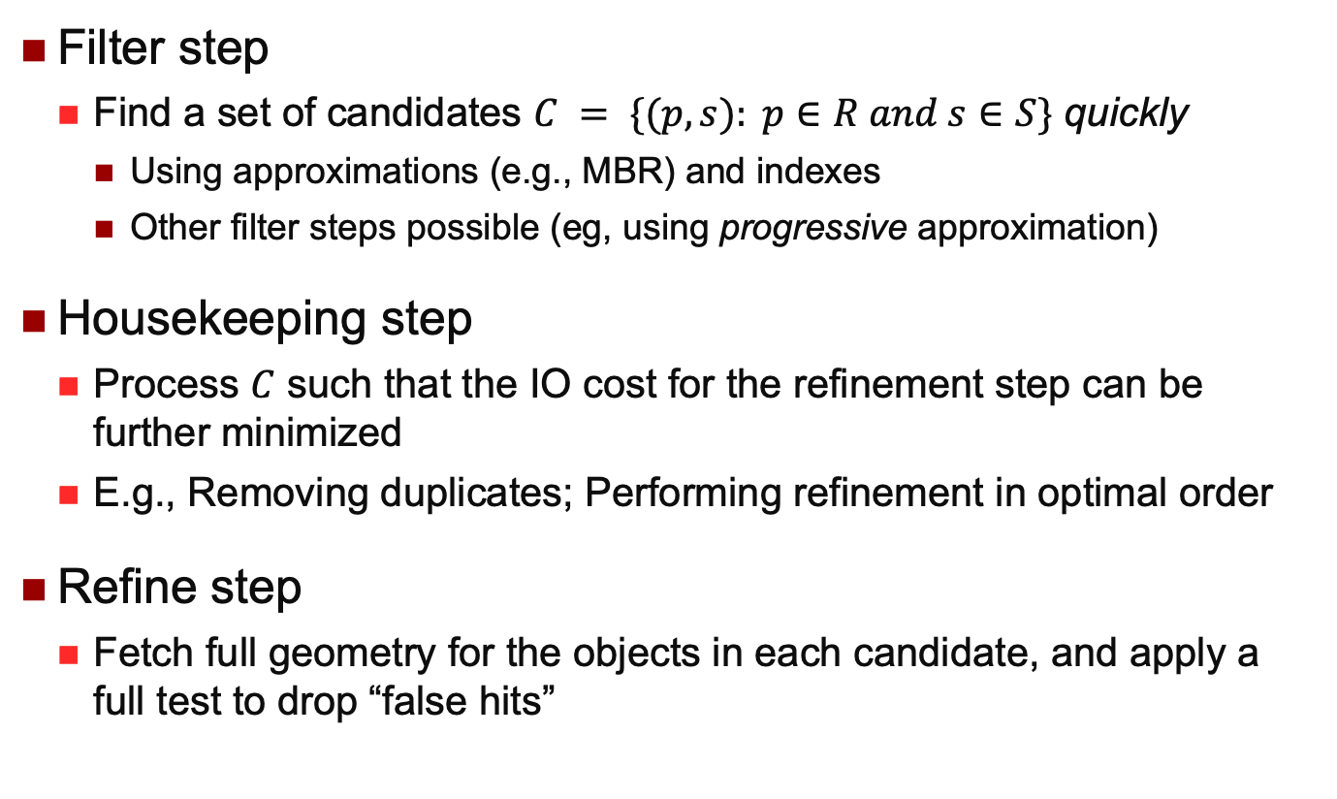
Processing Framework
Filter step
Find a set of candidates $C = \{(p, s): p∈R and s∈S\}$ quickly
Using approximations (e.g., MBR) and indexes
Other filter steps possible (eg, using progressive approximation)
Housekeeping step
Process $C$ such that the IO cost for the refinement step can be further minimized
E.g., Removing duplicates; Performing refinement in optimal order
Refine step
Fetch full geometry for the objects in each candidate, and apply a full test to drop “false hits”
Notes:
Different join solutions

Slide 27
Simple Nested-Loops Join
for each r in R
for each s in S
if (r,MBR intersect s.MBR)
put (r, s) to the candidate set;

Slide 28
Indexed Nested-Loops Join
Using a window query against S
for each r in R
Find all s in S such that s.MBR intersect r.MBR
put (r, s) to the candidate set;

Slide 29

Nested-Loops With R/R+-Trees
A
B
C
D
E
F
G
H
I
J
X
Is it possible to produce the same candidate ($p1$, $p2$) multiple times?
Reading: the paper by Brinkhoff, Kriegel and Seeger 1993.
Notes:
Property of R-tree/R+-tree
If the MBRs of two entries are disjoint, so must be all their children
If the MBRs of two entries intersect, then some children pairs might intersect somewhere down the tree/on the page

Slide 30
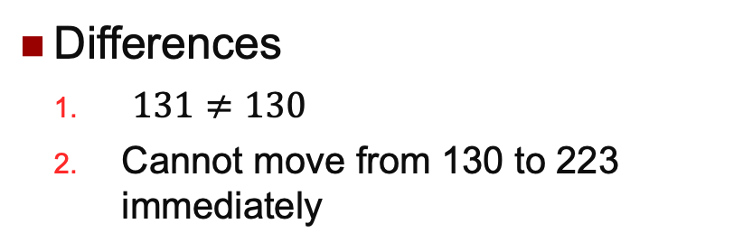
Sort-Merge Join using Z-values
r
s
113
131
133
220
222
414
434
443
130
223
400
Differences
$131≠130$
Cannot move from 130 to 223 immediately
220
414
400
222
223
443
434
Algorithm Sketch:
Two sorted lists and two pointers
Synchronized traversal
overlap(r, s)?
increase min(r, s)
Some values in stack
113
131
133
130
Reading: the paper by Orenstein and Manola 1988.

Slide 31
Thank you!
Notes:
You must be familiar with week 6’s content.

